Slide 1
Derivatives and Risk Management
Reasons for managing risk
Introduction to Derivatives
Options Types and Markets
Factors affecting the value of option
Exercise value versus option price
Forward and Future contracts
Other Types of Derivatives:
Swap
Structured Notes
Inverse Floaters
Using Derivatives to reduce risk
Risk Management and Risk Management Approaches

Slide 2
Reason for Managing Risk
Risk is defined as variability in returns
Risk is the possible event which could have adverse financial consequences
Risk Management: identification of possible event that could have adverse financial consequences and taking the measures to prevent or minimize financial losses
Reason for Risk Management:
Debt Capacity
Maintaining the optimum capital budgeting
Financial distress
Comparative advantage in hedging
Borrowing costs
Tax effects
Compensating System
Arbitrage Opportunities

Slide 3
Classification of Risk
Pure Risk
Speculative Risk
Demand Risk
Input Risk
Financial Risk
Property Risk
Personnel Risk
Environmental Risk
Third party Liability Risk
Transferable Risk

Slide 4
Risk Management Approach
Identification of Potential Risk
Measure the Potential Effect of Each Risk
Decide the Risk Handling Methods
Buying the Insurance Policy
Transferring the Function
Using the Derivative Securities
Reducing the Probability of Occurrence of an Adverse Event
Reducing the magnitude of the Loss from an Adverse Event
Avoiding the Activity that Increases the Risks
Evaluation of the Risk Handling Methods

Slide 5
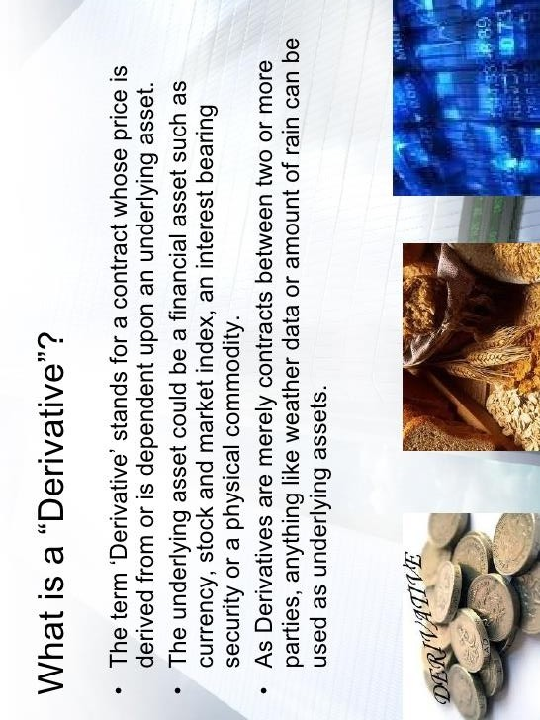

Slide 6
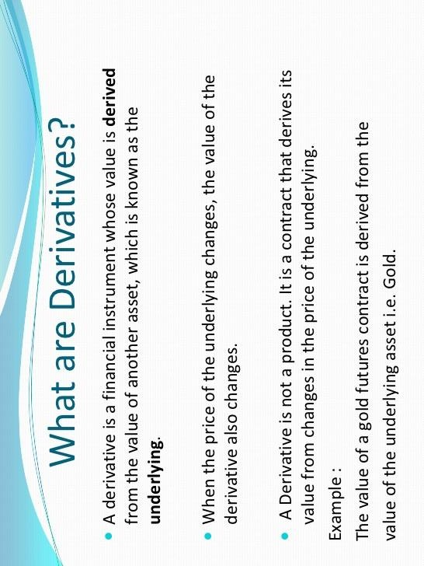

Slide 7
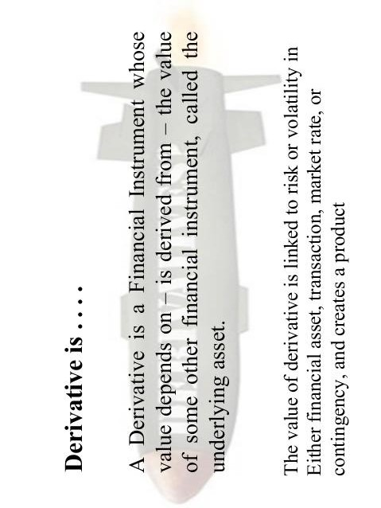

Slide 8
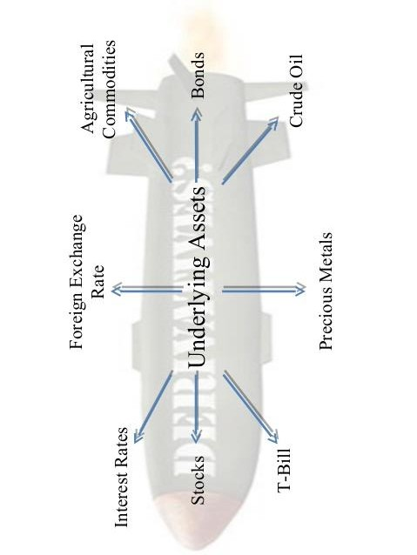

Slide 9
Features of financial derivatives
Derive value from an underlying assets
Two parties
Legally binding contracts
Predetermined life
Involves forward transactions
Zero-sum game
Derivative is an assets

Slide 10
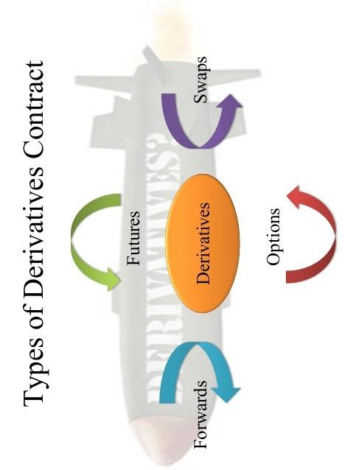

Slide 11
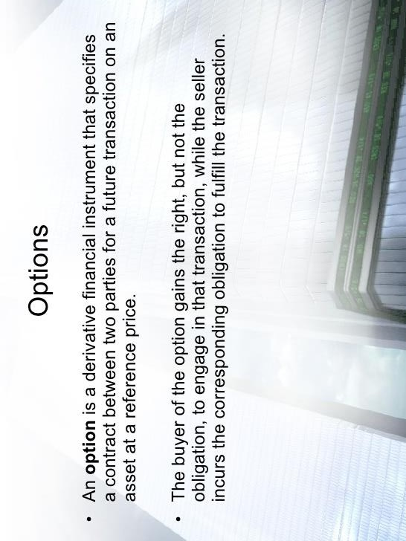

Slide 12
Types
Option
(Right to….)
Buy
(Call option)
Sell
(Put option)
Buyer of Call option
Seller of Call option
Buyer of Put option
Seller of Put option

Slide 13
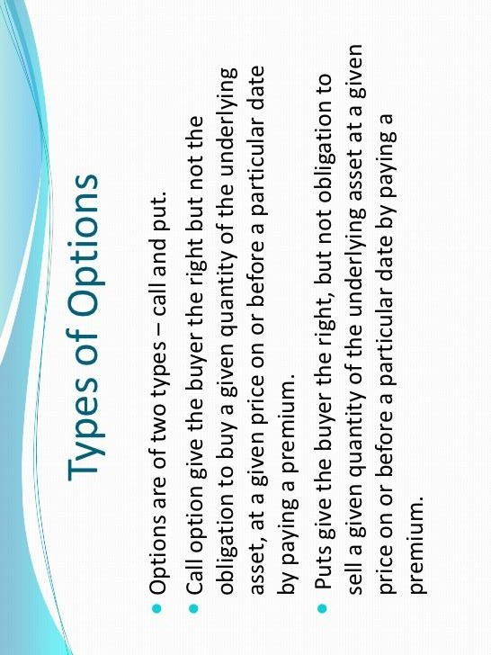

Slide 14
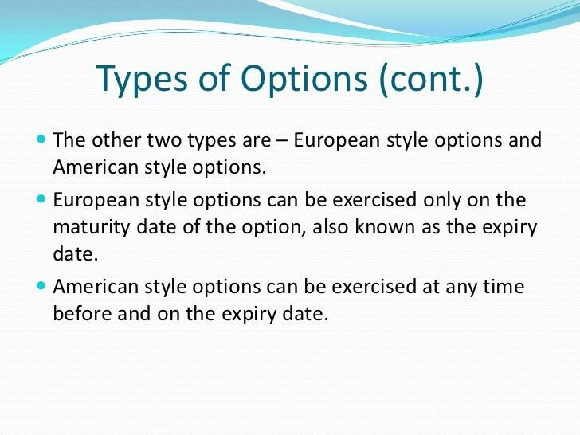

Slide 15
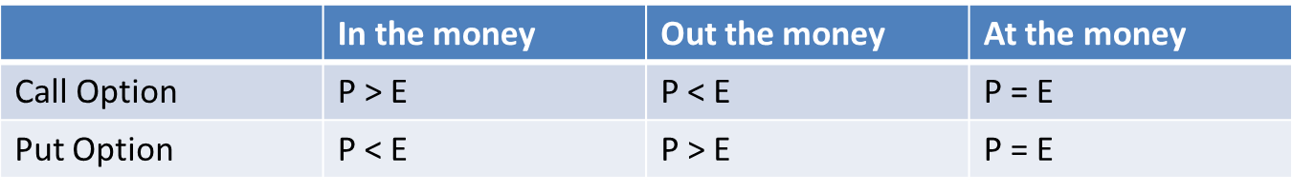
Option Terminologies
Option Price
Exercise/Strike Price
Expiration Date
Underlying Assets
Exercising the options
In-the-Money Option
Out-of-the Money Option
At-the-Money
Option Position

Slide 16
Option Transaction
Call Option
Long Call
Cash flow received by exercising the call is called call payoff, C1 and it is calculated as follows:
C1 = (Max (ST-E), 0)
Example:
Profit from buying one European call option: option price = Rs 5, strike price = Rs100, option life = 2 months

Slide 17
Long Call Option
i) Stock Price at time T | ii) Exercise Price | iii) Payoff from long call Max (ST-E), 0) | iv)Option Price | v)Overall Profit for long call V= iii+iv
70 | 100 | Max(70-100),0)= 0 | -5 | -5
80 | 100 | Max(80-100),0)= 0 | -5 | -5
90 | 100 | Max(90-100),0)= 0 | -5 | -5
100 | 100 | Max(100-100),0)= 0 | -5 | -5
105 | 100 | Max(105-100),0)= 5 | -5 | 0
110 | 100 | Max(110-100),0)= 10 | -5 | 5
120 | 100 | Max(120-100),0)= 20 | -5 | 15
130 | 100 | Max(130-100),0)= 30 | -5 | 25

Slide 18
Long Call
30
Profit (Rs)
20
10
Terminal
stock price (Rs)
70
80
90
100
0
-5
110
120
130

Slide 19
Short Call Option
Call Option
Short Call
Cash flow received by exercising the call is called call payoff, C1 and it is calculated as follows:
C1 = -Max (ST - E), 0)
Example:
Profit from selling one European call option: option price = Rs 5, strike price = Rs100, option life = 2 months

Slide 20
Short Call Option
i) Stock Price at time T | ii) Exercise Price | iii) Payoff from short- call (-)Max (ST-E), 0) | iv)Option Price | v)Overall Profit for short call V=iii+iv
70 | 100 | -Max(70-100),0)= 0 | 5 | 5
80 | 100 | -Max(80-100),0)= 0 | 5 | 5
90 | 100 | -Max(90-100),0)= 0 | 5 | 5
100 | 100 | -Max(100-100),0)= 0 | 5 | 5
105 | 100 | -Max(105-100),0)= -5 | 5 | 0
110 | 100 | -Max(110-100),0)= -10 | 5 | -5
120 | 100 | -Max(120-100),0)= -20 | 5 | -15
130 | 100 | -Max(130-100),0)= -30 | 5 | -25

Slide 21
Short Call
Profit (Rs)
5
110
120
130
0
70
80
90
100
Terminal
stock price (Rs)
-10
-20
-30

Slide 22
Put Option
Long Put
Cash flow received by exercising the put is called put payoff, P1 and it is calculated as follows:
P1 = Max (E-ST), 0)
Example:
Profit from buying a European put option: option price = Rs7, strike price = Rs70, time 2 months

Slide 23
Long Put Option
i) Stock Price at time T | ii) Exercise Price | iii) Payoff from long Put Max (E-ST), 0) | iv)Option Price | v)Overall Profit for long put V=iii+iv
40 | 70 | Max(70-40),0)= 30 | -7 | 23
50 | 70 | Max(70-50),0)= 20 | -7 | 13
60 | 70 | Max(70-60),0)= 10 | -7 | 3
63 | 70 | Max(70-63),0)= 7 | -7 | 0
70 | 70 | Max(70-70),0)= 0 | -7 | -7
80 | 70 | Max(70-80),0)= 0 | -7 | -7
90 | 70 | Max(70-90),0)= 0 | -7 | -7
100 | 70 | Max(70-100),0)= 0 | -7 | -7

Slide 24
Long Put
Long put
30
Profit ($)
20
10
Terminal
stock price ($)
0
40
50
60
70
80
90
100
-7

Slide 25
Short Put
Short Put
Cash flow received by exercising the put is called put payoff, P1 and it is calculated as follows:
P1 = -Max (E-ST), 0)
Example:
Profit from selling a European put option: option price = Rs7, strike price = Rs70, time 2 months

Slide 26
Short Put Option
i) Stock Price at time T | ii) Exercise Price | iii) Payoff from short Put -Max (E-ST), 0) | iv)Option Price | v)Overall Profit for short put V=iii+iv
40 | 70 | -Max(70-40),0)= -30 | 7 | -23
50 | 70 | -Max(70-50),0)= -20 | 7 | -13
60 | 70 | -Max(70-60),0)= -10 | 7 | -3
63 | 70 | -Max(70-63),0)= -7 | 7 | 0
70 | 70 | -Max(70-70),0)= 0 | 7 | 7
77 | 70 | -Max(70-77),0)= 0 | 7 | 7
80 | 70 | -Max(70-80),0)= 0 | 7 | 7
90 | 70 | -Max(70-90),0)= 0 | 7 | 7
100 | 70 | -Max(70-100),0)= 0 | 7 | 7

Slide 27
Short Put
Profit ($)
Terminal
stock price ($)
7
40
50
60
0
70
80
90
100
-10
-20
-30

Slide 28
Factors affecting value of call option
Exercise Price
Current Stock Price
Time to Expiration
Interest Rate
Stock Volatility

Slide 29
Future and Forward Contract
Forward Contact
It is a derivative security
Agreement today between two parties to buy or sell an asset at a certain future time for a fixed price
Privately negotiated , subject to limited regulatory oversight, possibilities of default
Buyer of forward contract has right and obligation to buy and the seller of forward transaction has right and obligation to sell as per contract.
Traded Over the Counter (OTC market)
Payoff from a long position in a forward contract is S_{t} – F₀
Payoff from a short position in a forward contract is F₀ – S_{t}

Slide 30
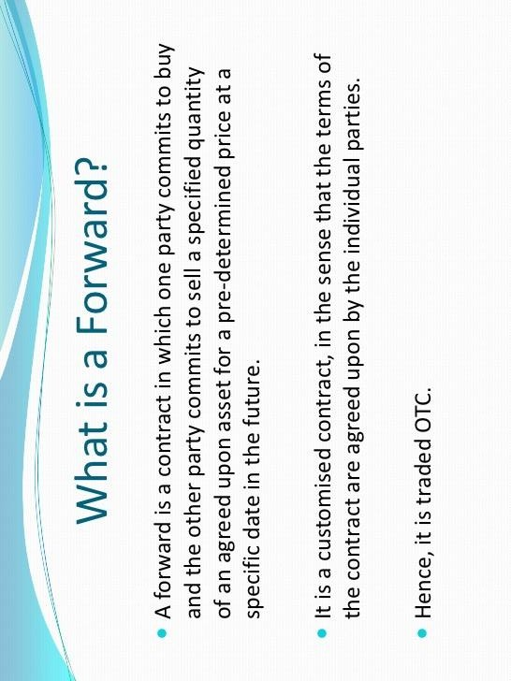

Slide 31
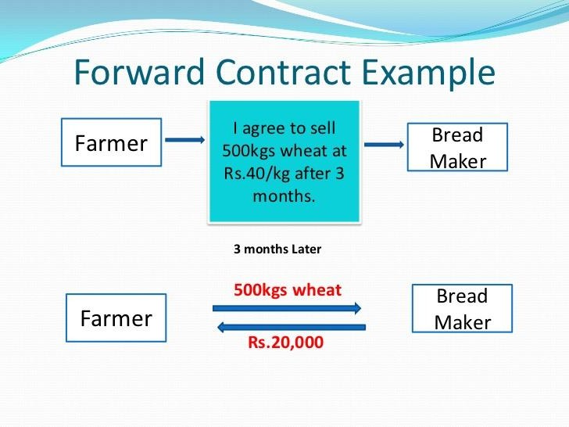

Slide 32
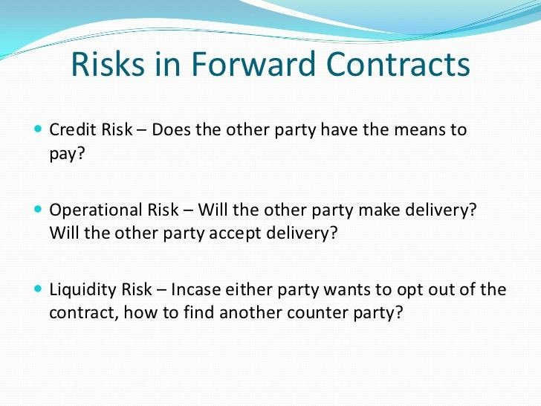

Slide 33
Future Contract
Similar to forward contract but future contract are traded in futures exchange which gives guarantee to contracting parties.
Price agreed on today
Have standardized underlying assets, quantities and expirations and performance is guaranteed by a clearing house.
Daily settlement of gains and losses.
Daily settlement is also called marked to market.
Credit risk is reduced/ eliminated by several means
Guarantees the performance on the contract to both parties
Future contract are closed before maturity, but most of times physical delivery of underlying assets may not take place.

Slide 34
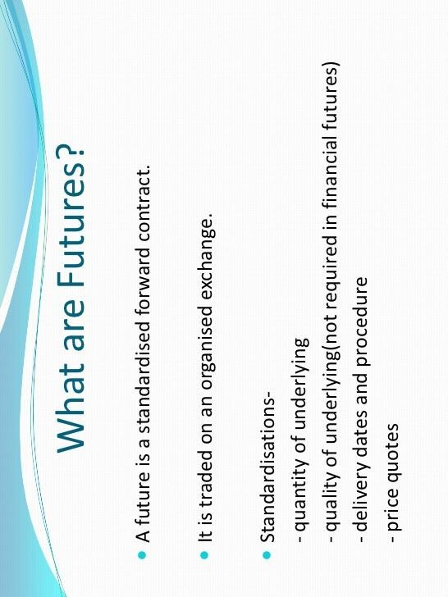

Slide 35
Future Contracts Vs Forward Contracts
FORWARDS
FUTURES
Private contract between 2 parties
Exchange traded
Non-standard contract
Standard contract
Usually 1 specified delivery date
Range of delivery dates
Settled at end of contract
Settled daily
Delivery or final cash
settlement usually occurs
prior to maturity
Some credit risk
Virtually no credit risk

Slide 36
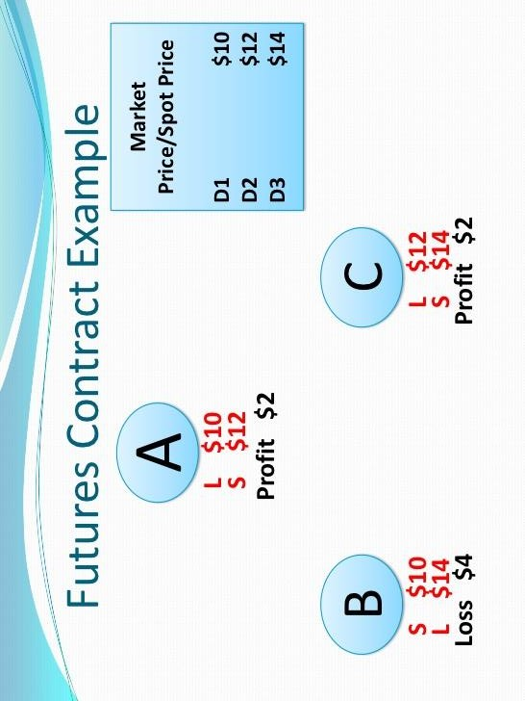

Slide 37
Other Types of Derivatives
Swaps:
A swap is an agreement between two parties to exchange sets of cash flows over a period of time.
It can be define as a transaction between two parties in which each party agrees to pay the other a series of cash flows at specified dates over a specified period of time based on agreed principal amount.
The principal amounts plays a conceptual role in determining the amount of a series of payments under swap contract. In a swap, the payments are calculated based on specific amount of principal, which is called notional principal .
Notional principal is the amount fixed in a swap on which interest payments are based on this amount is not exchanged generally.
Swap do not involve a cash up front payment from one counter party to another. Thus, a swap has zero value at the start that means the present value of two streams of payments are set equal at the start of swap contract.
Swaps are exclusively customized ( i.e. terms and condition can be set as per requirements of parties involved) and over the counter market instruments.
Like forward contracts, swaps are subject to the risk that given party could default. Wherever possible the payments are netted so that only the difference between two payments is paid by the party paying higher payment to counter party.

Slide 38
The Swap Market
The market which carries out the transaction on swaps.
It is unregulated market in that no government agency has oversight responsibilities unlike in futures and option exchange.
Swap Market has some inherent limitations:
Potential counterparty must find another counterparty that is willing to take opposite side of the transactions. (However limitation has been considerably reduced by swap dealers by taking either side of transaction)
Since swap is the contract between two parties, it cannot be terminated or altered without consent of both parties.
No third party to guarantee the payment from other counter party
There are four major types of swaps:
Interest rate swap
Currency Swap
Equity Swap
Commodity Swap

Slide 39
Interest rate Swap
An interest rate swap is a swap in which the two parties agree to exchange a series of interest payments in same currency.
The parties generally do not exchange principal amount since this would involve each party giving the other party the same amount of money.
Interest rate swap are also 2 types:
Plain vanilla Interest rate swap
Basis Swap
Plain Vanilla Interest rate swap
Most common type of interest rate swap in which one party pays fixed rate of interest and the other party pays floating rate of interest.
In plain vanilla interest rate swap one party has initial position in a fixed debt instrument, while other has an initial position in a floating rate obligation.
By swapping the interest rate they change their liabilities
The most popular short term, floating rates used in vanilla interest rate swaps today include the London Inter Bank Offered Rate (LIBOR) on Eurodollar deposits rate, Treasury bill rate, the prime bank rate, the central bank fund rate, and interest rate on bank and thrift certificate of deposits (CDs) and commercial paper.

Slide 40
Basis Swap
A swap in which both parties make payment at different floating rate is called basis swap.
One common type of basis swap is where one side pays the Treasury bill rate and other pays LIBOR.
Interbank rate will always be more than Treasury bill rate because inter-bank rate reflects credit risk or default risk . Therefore the party receiving LIBOR will always receive higher rate and party receiving treasury rate will always bear a loss.
Hence spread is added to lower rate (treasury rate ) or deducted from higher rate (LIBOR). Finding this spread is known as the pricing of basis swap.

Slide 41
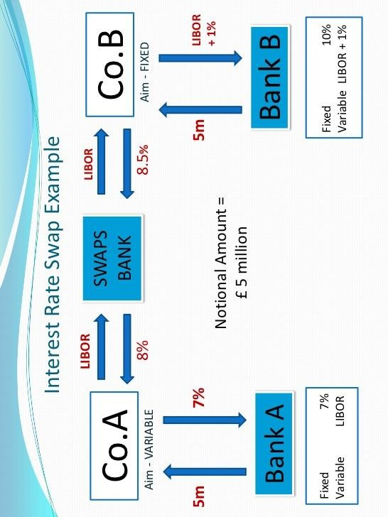

Slide 42
Currency Swap
A currency swap is a contract between two parties to exchange series of cash flows in different currencies.
Either or both sets of payments can be fixed or floating
The principal amount are usually exchanged at the beginning and at the end of the life of the swap. Principal amounts are chosen to be equivalent using the exchange rate at the swap initiation.
As the payments in a currency swap are in different currencies, they are typically not netted.
Cash flow Structure in a Currency swap includes 3 sets of cash flow
The exchange of principal amount at the initiation
Exchange of interest payments on each settlement date during the life of swap
Re-exchange of principal amounts at the end of swap contract.

Slide 43
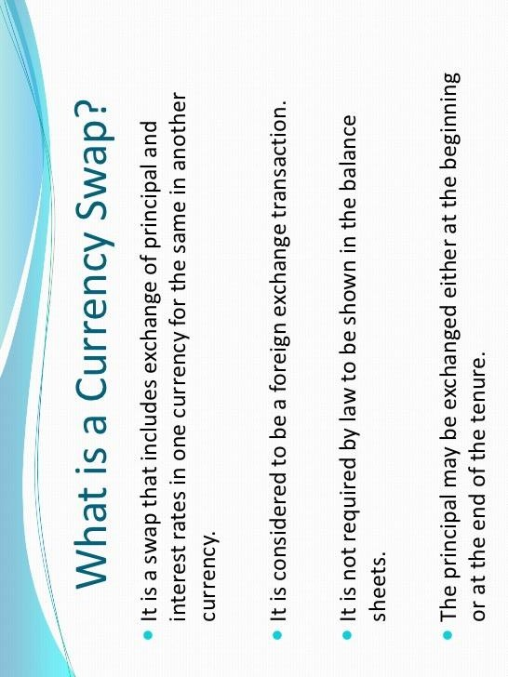

Slide 44
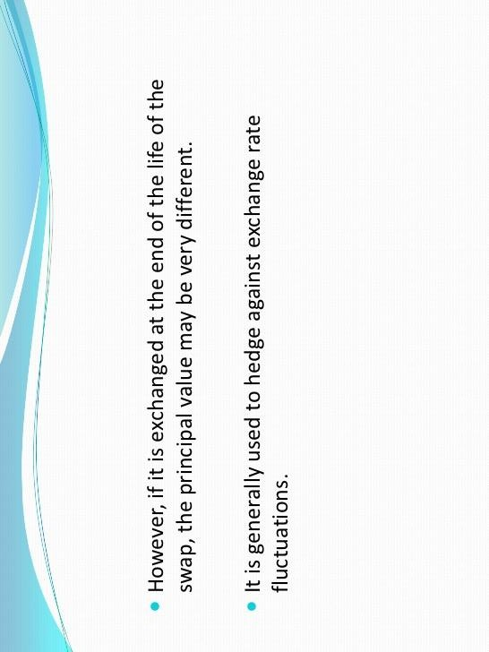

Slide 45
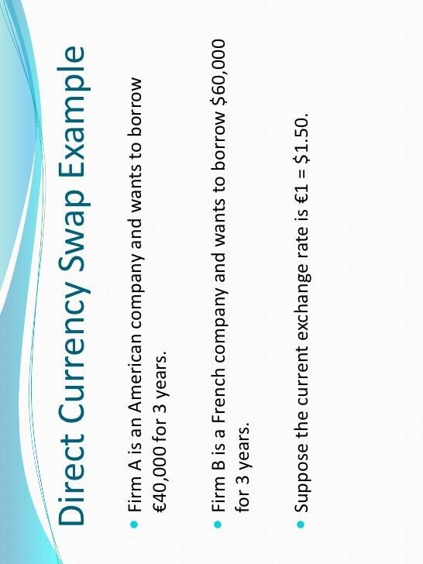

Slide 46
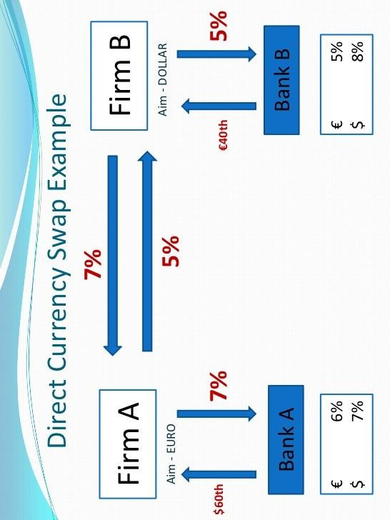

Slide 47
Equity Swap and Commodity Swap
Equity Swap: Equity swap is a swap in which two parties agree to exchange a series of payment based on a specific motional principal. In equity swap, at least one of the two stream of cash flows is determined by a stock price, the value of stock portfolio, or level of stock index. The other stream of cash flows can be a fixed rate, floating rate such as LIBOR, or it can also be determined by value of another stock, stock portfolio or stock index. Since at least one payment of equity swap depends on the return on stock or stock index, it cannot be known in advance like floating payment in plain vanilla swap.
Commodity Swap: Commodity swap is a swap agreement in which one counterparty makes periodic payments at a per unit fixed price for a given quantity of some commodity and second counterparty pays per unit floating price for a given quantity of same commodity. Notional principal in a commodity swap is quantity of goods rather than an amount as in other swaps. The commodities may be the same (the usual case) or different. If they are same then no exchange is required. If they are different, exchange of notional could be required but as a general rule, no exchange of notional take place- all transactions take place in cash markets and the parties make only net payments. A commodity swap may be regarded as a plain vanilla swap as one party pays fixed rate and other party pays a floating rate based on market price.

Slide 48
Structured Notes
A structured note is a hybrid security. It combines the features of multiple different financial products into one. They combine bonds and additional investments to offer the features of both debt assets and investment assets. Structured notes aren't direct investments, but rather they're derivatives.
Structure notes are debt obligations that are derived from debt obligation.
Structure notes are notes backed by interest and principal payments on mortgages.

Slide 49
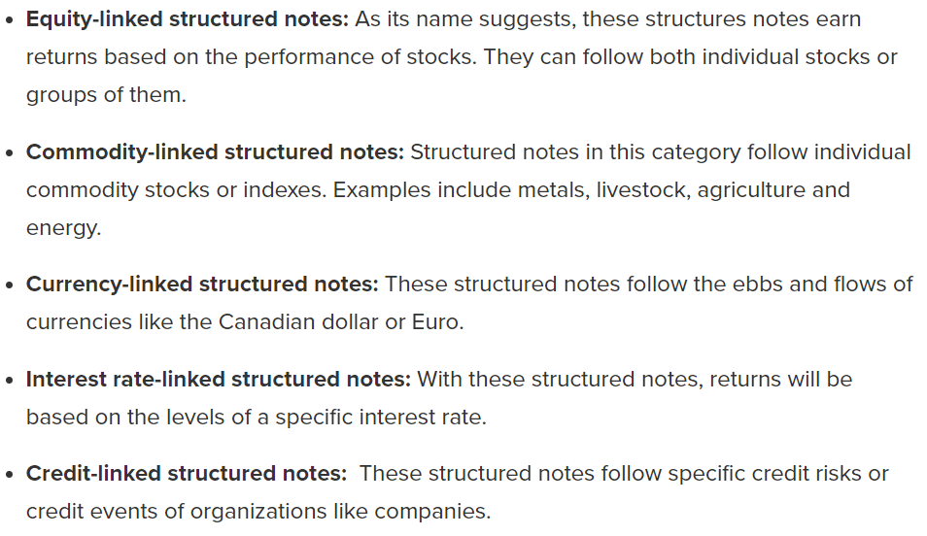
Types of Structure Notes

Slide 50
Inverse Floaters
Interest rate on some notes move inversely with market rate
Inverse floaters are those notes whose interest rate moves inversely with market interest rate.
Discount rate used to value the cash flows of inverse floaters increase with increase along the market rate
Combined effects of lower cash flows and a higher discount rate brings about the sharp decline in value of inverse floaters. Thus high vulnerable to increase in interest rate.
An inverse floating rate note or simply called an inverse floater is a debt instrument (typically a bond) whose coupon payment follows an opposite direction to that of a benchmark interest rate.

Slide 51
Using Derivatives to Reduce Risk
Will discuss on the class

